Slide 1
AngularJS
Introduction to
Bootstrap

Slide 2
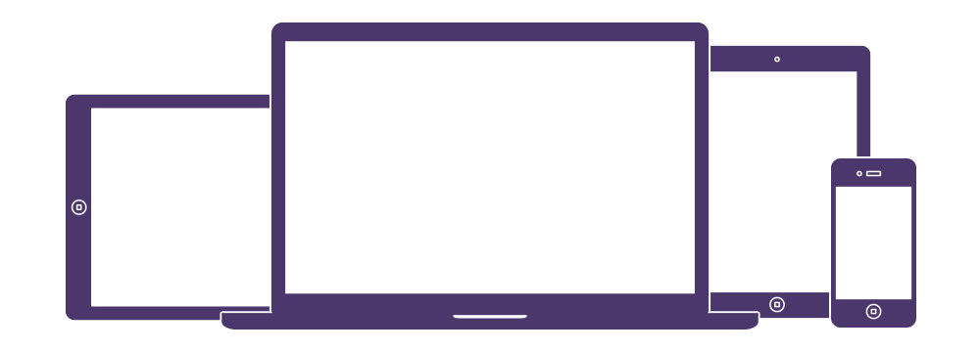
www.getbootstrap.com
Bootstrap is Front-end Framework
HTML, CSS, and JS framework for developing responsive, mobile first projects on the web.

Slide 3

Bootstrap is Ready-to-use Web Elements
HTML / CSS elements for button, form, table, image, navbar, label, progress bar, alert etc.

Slide 4
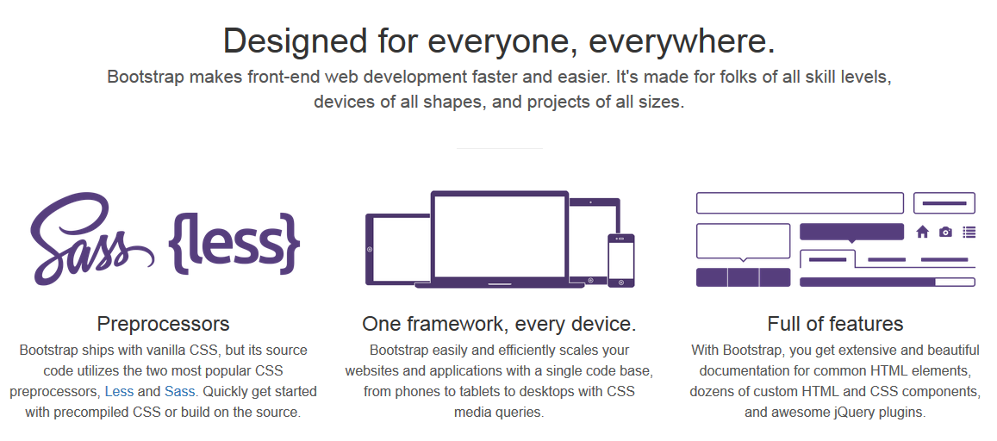
Bootstrap

Slide 5
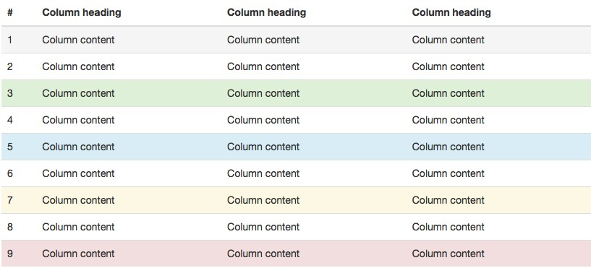
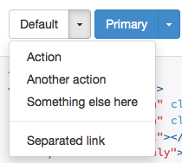
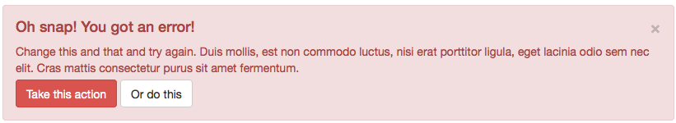
Examples of Bootstrap components

Slide 6
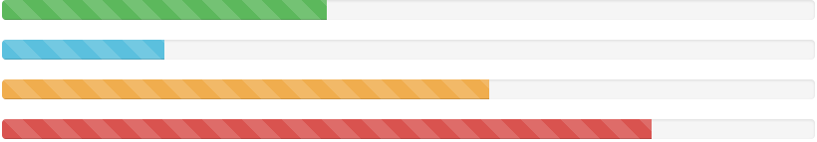
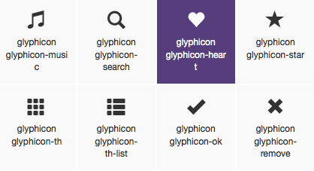

More examples of Bootstrap components

Slide 7
List of Bootstrap components
Glyphicons
Dropdowns
Button groups
Button dropdowns
Input groups
Navs
Navbar
Breadcrumbs
Pagination
Labels
Badges
Jumbotron
Page header
Thumbnails
Alerts
Progress bars
Media object
List group
Panels
Responsive embed
Wells

Slide 8
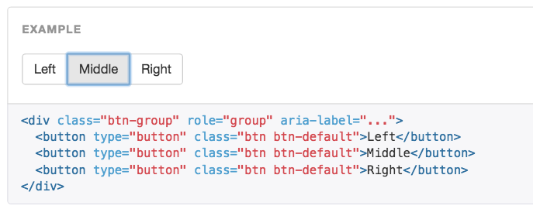
Example: button groups

Slide 9
Why Bootstrap?
Save 100+ hours of coding
Easy to use web elements
Quick responsive prototype / website
Great documentation

Slide 10
Bootstrap package
CSS - bootstrap.css
JS - bootstrap.js
Icon Fonts - glyphicons-halflings-regular.ttf

Slide 11
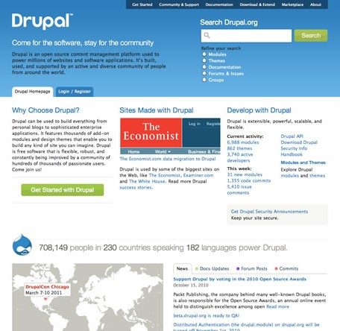
What is Grid?

Slide 12
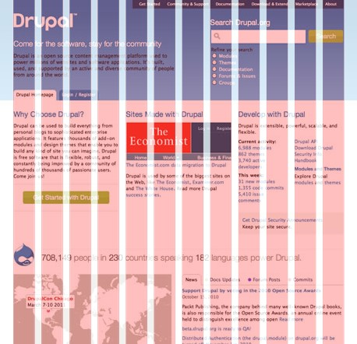
What is Grid?
1 2 3 4 5 6 7 8 9 10 11 12
12 Grid

Slide 13
What is Grid?
4 Grid
4 Grid
4 Grid
4 Grids x 3 Columns
= 12 Grids

Slide 14
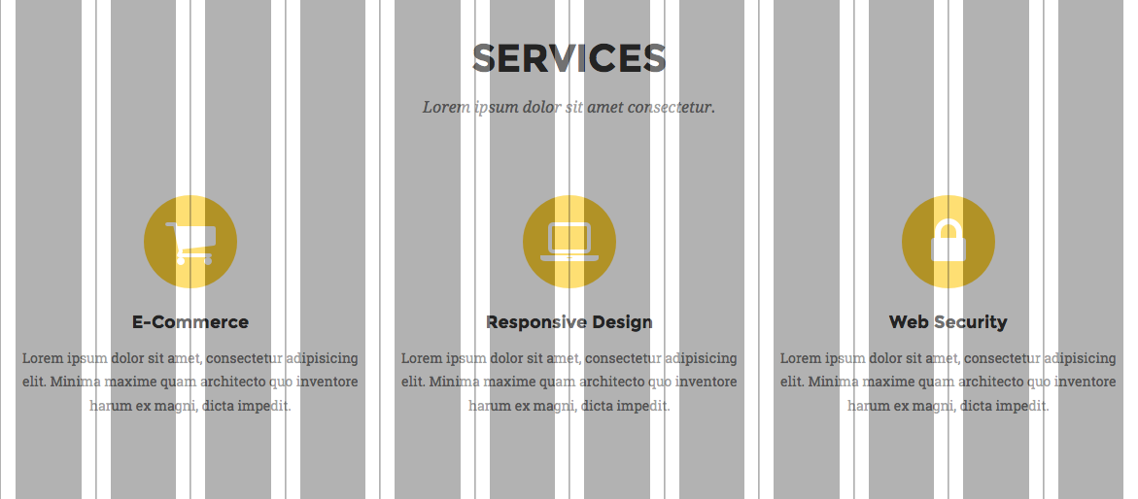
Bootstrap Grid
12 Responsive Grid

Slide 15
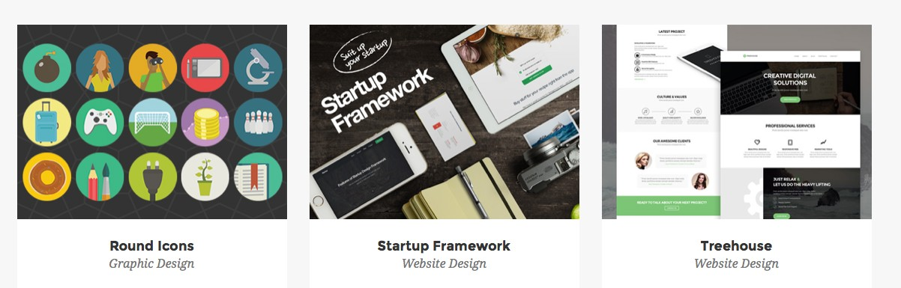
Bootstrap Grid example
How many grids in each box?

Slide 16
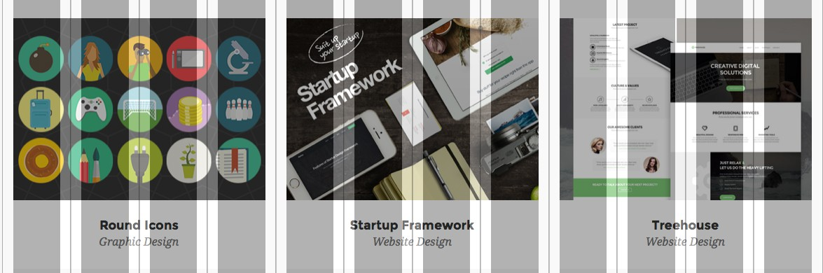
Bootstrap Grid example
4 grids x 3 Columns

Slide 17
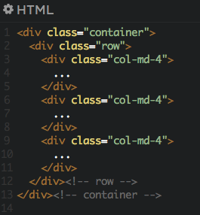
Bootstrap Grid example

Slide 18
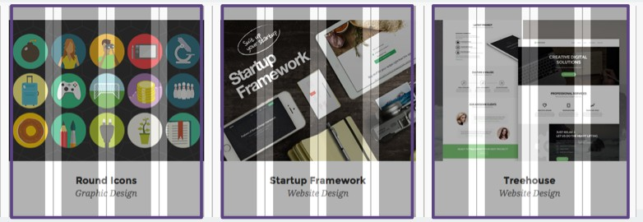
Bootstrap Grid example

Slide 19
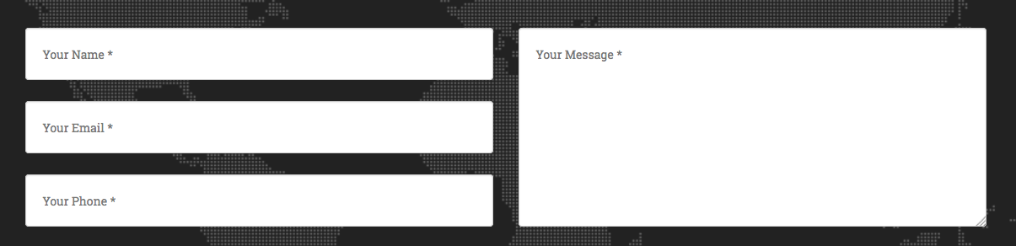
Bootstrap Grid example
How many grids in each box?

Slide 20
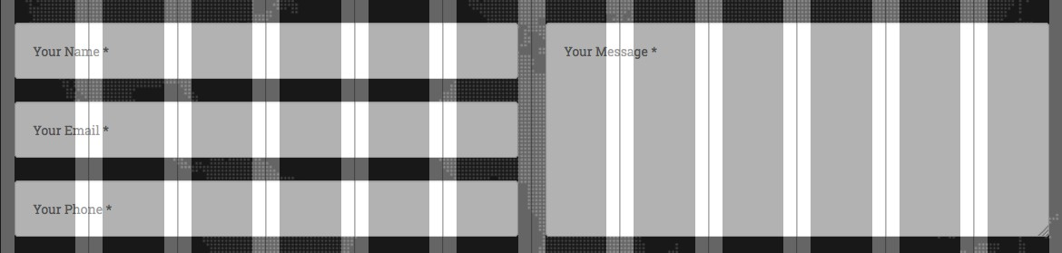
Bootstrap Grid example
6 grids x 2 Columns

Slide 21
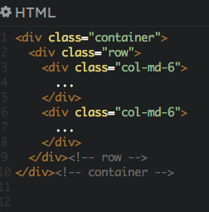
Bootstrap Grid example

Slide 22
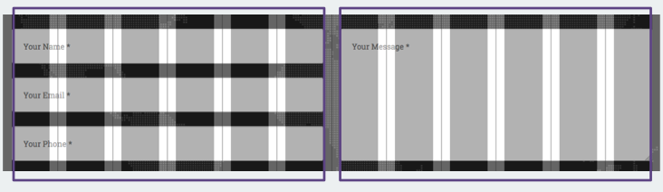
Bootstrap Grid example

Slide 23
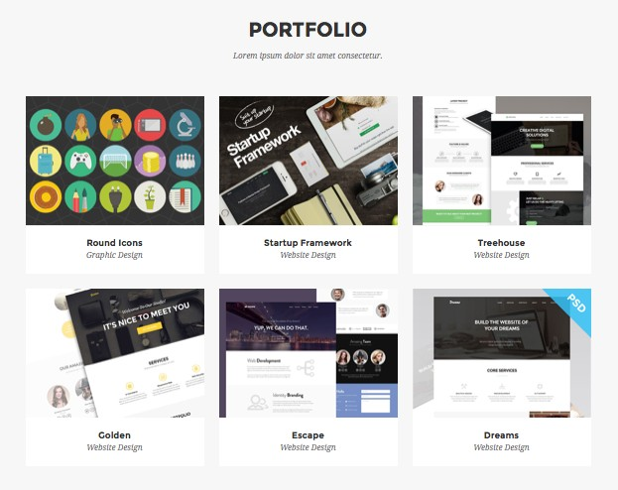
Bootstrap Rows
1 Row = 12 Grids

Slide 24
Bootstrap Rows
3 Rows

Slide 25
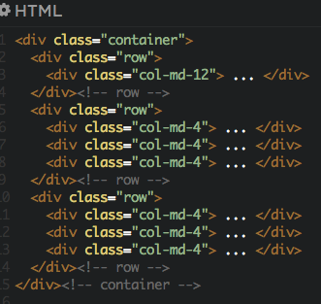
Bootstrap Rows

Slide 26
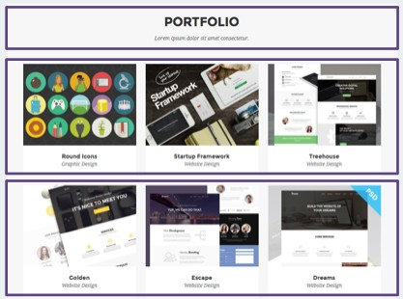
Bootstrap Rows

Slide 27
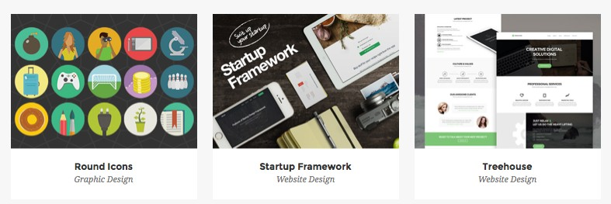
Bootstrap Responsive Grid
Columns will stack when responsive

Slide 28
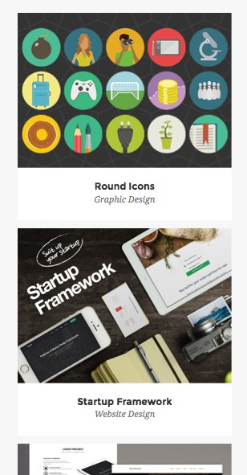
Bootstrap Responsive Grid
Desktop Mobile
1
2 3
1
2
Columns stack on mobile
3

Slide 29
4 sizes of Grid
Size Name | Screen Size | CSS Class
Extra Small Devices (Phone) | 0 - 767 px | .col-xs-1 ~ .col-xs-12
Small Devices (Tablet) | 768 - 991 px | .col-sm-1 ~ .col-sm-12
Medium Devices (Desktop) | 992 - 1219 px | .col-md-1 ~ .col-md-12
Large Devices (Large screen desktop) | 1200px + | .col-lg-1 ~ .col-lg-12

Slide 30
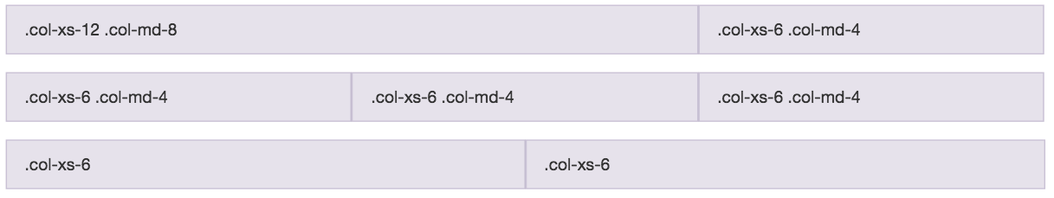
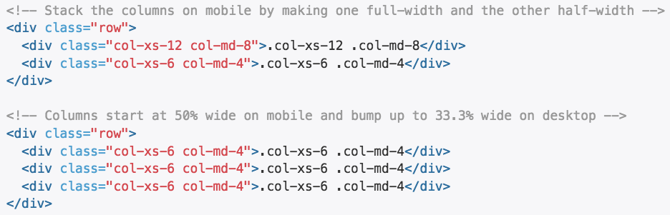
Example: mobile and desktop

Slide 31
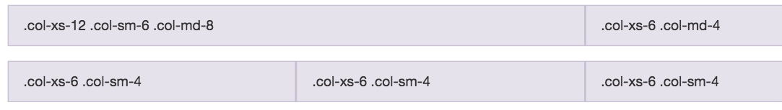
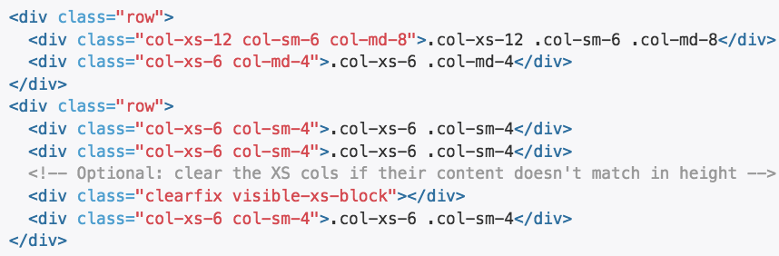
Example: Mobile, tablet, desktop

Slide 32
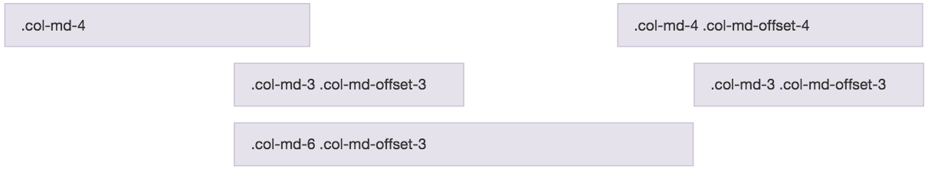
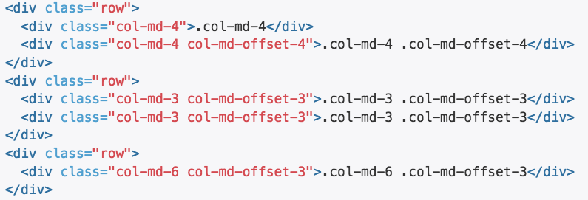
Offsetting columns

Slide 33
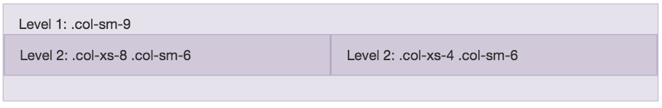
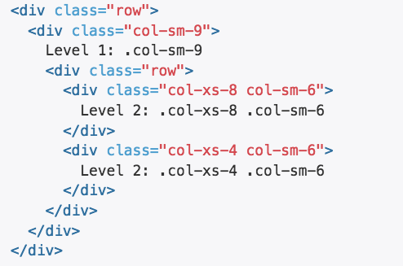
Nested rows

Slide 34
Task 8
Sections

